Slide 1
Research internship 2023
By Callum Hurd and Ralph Davies

Slide 2
In this project we endeavour to take
“An investigation into numerical and statistical methods for solving SDE's, estimating their parameters and their applications in predicting stock price”
Simulations in R and Python
View of writing an algorithm connected to quant connect

Slide 3
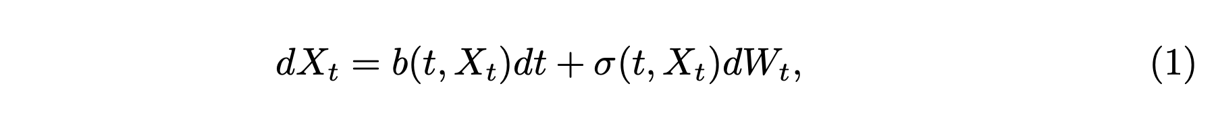
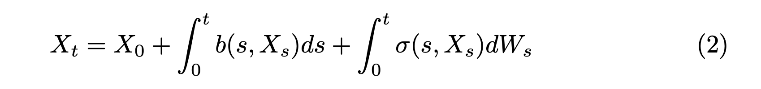
What is an SDE?
In general, an SDE can be thought of as an ODE, where one or more of the terms is (or a function of) a stochastic process.
The SDE’s we will consider will take the form of an ODE + Gaussian noise, otherwise known as Brownian motion.
This can be understood in the following two ways as presented below. Where we take the integrals under the Itô formalism, and X_0 is the (potentially stochastic) initial condition.

Slide 4
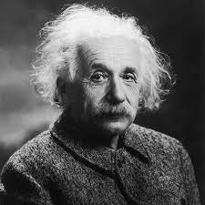
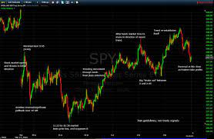

Why are SDE’s useful
SDE’s are useful in any setting where you wish to model a dynamical system that must incorporate some random noise. They crop up throughout physics, initially stemming from field of Brownian motion - influenced primarily by none other than Albert Einstein.
They are also important in probability theory and (of course) the application of this to the field of mathematical finance, which is what we endeavour to focus on in this project.

Slide 5
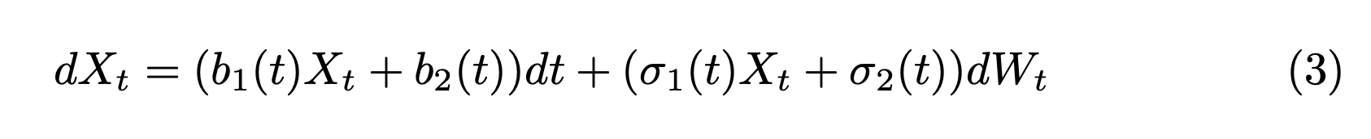
Types of SDE’s and their solutions
Most SDE’s are completely un-solvable analytically, and so we must take to numerical methods to estimate and approximate these solutions.
There are however, some specific cases where it is possible to find a closed form solution to the SDE and we will discuss the utility of this later on.
The class of SDE’s for which we will provide a solution to are called Linear SDE’s (so named for the linearity of the coefficients b and sigma in the stochastic term, X_t.
The general form of this type of SDE is given below.
With initial condition X_0

Slide 6
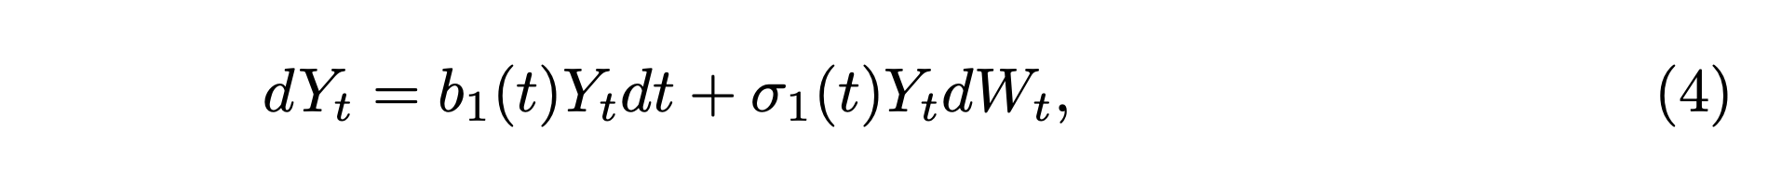
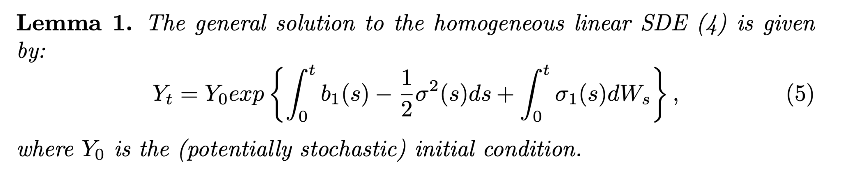
The homogeneous linear SDE
To find the general solution, we first examing the homogeneous case below.
1

Slide 7
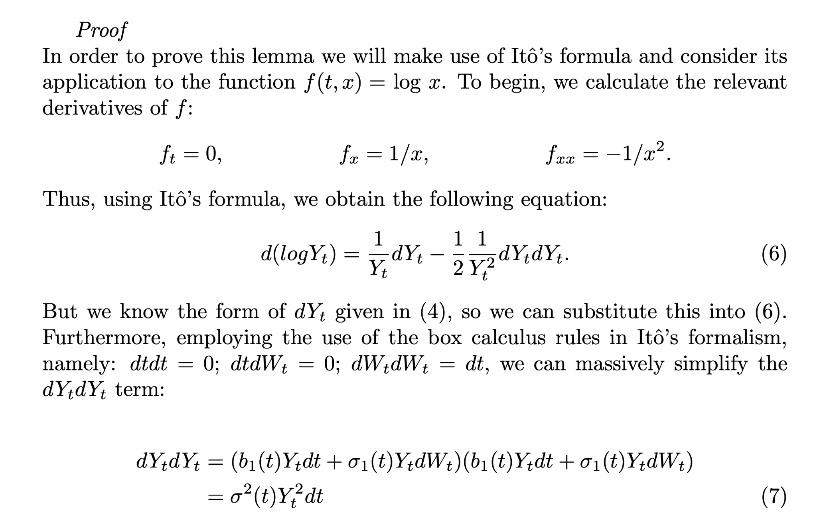
The homogeneous linear SDE
1

Slide 8
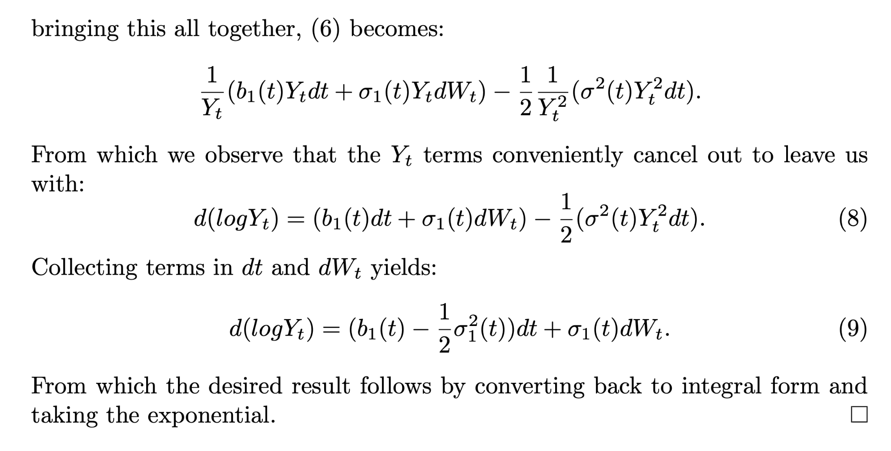
The homogeneous linear SDE
1

Slide 9
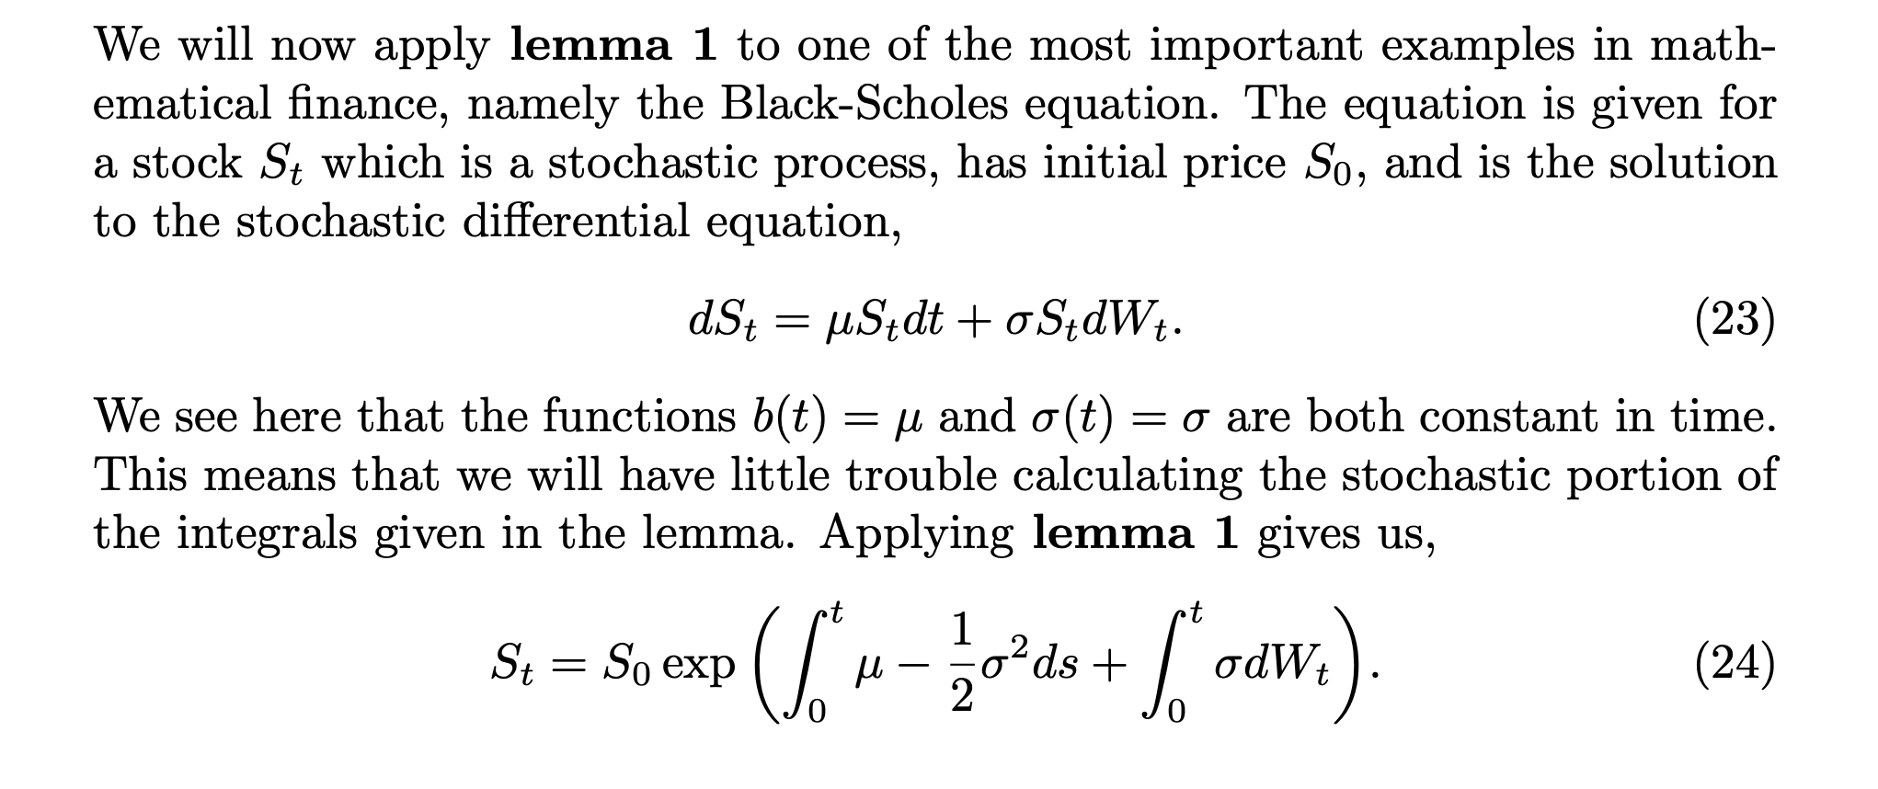
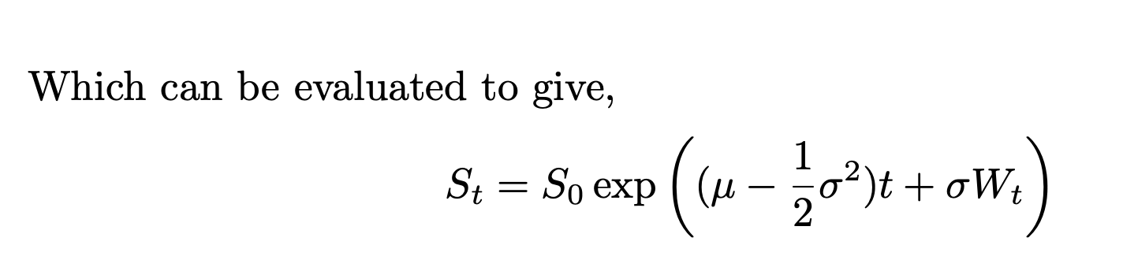
Application to Black-Scholes

Slide 10
The Utility of the explicit form
Can draw data-points directly from the transition density since it has a known functional form.
Eliminates error
Can be computationally effective compared to some approximation schemes.

Slide 11
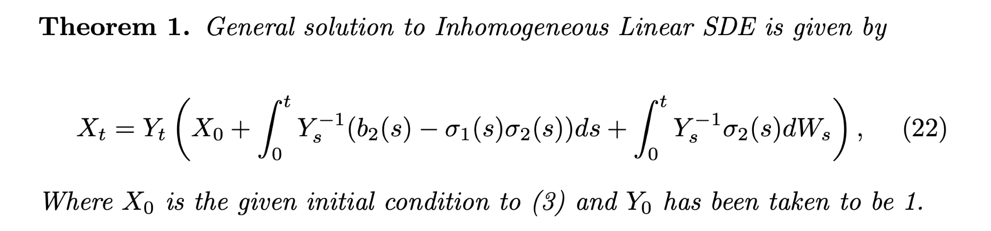
The Inhomogeneous Linear SDE

Slide 12
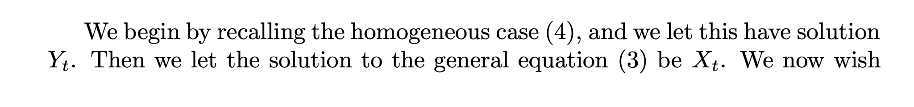
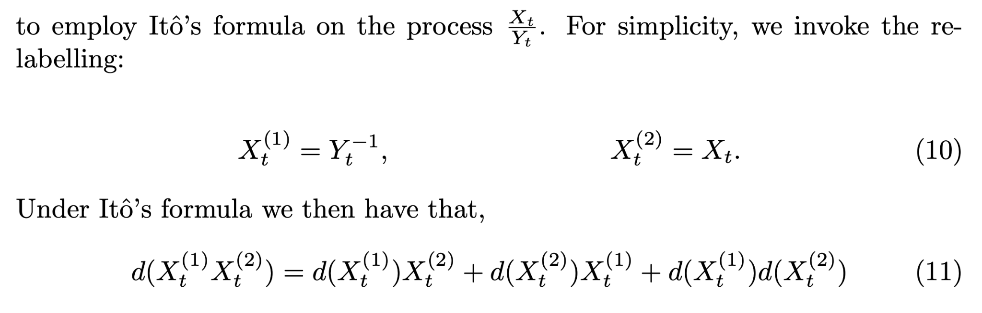
The Inhomogeneous Linear SDE
The solution to the inhomogeneous case can be found in a similar fashion to finding inhomogeneous solutions to ODE’s.
We expect that the full solution should incorporate the homogeneous solution in some way.
Again we will use Itô’s lemma and give a brief sketch of the proof.

Slide 13
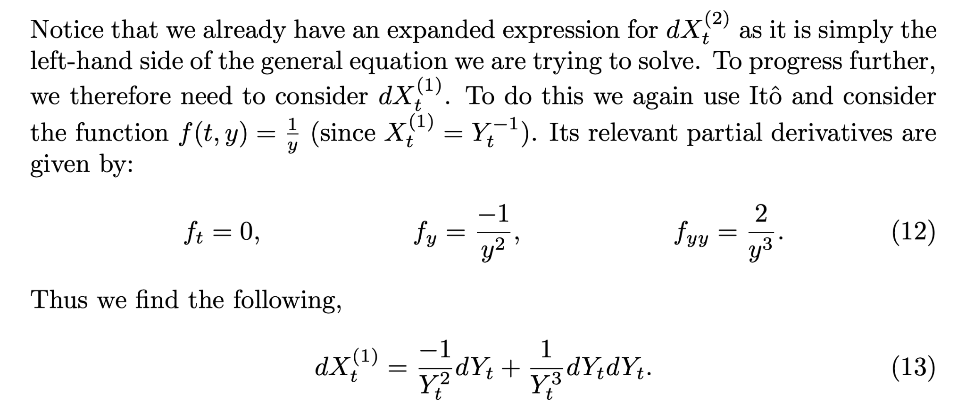
The Inhomogeneous Linear SDE

Slide 14
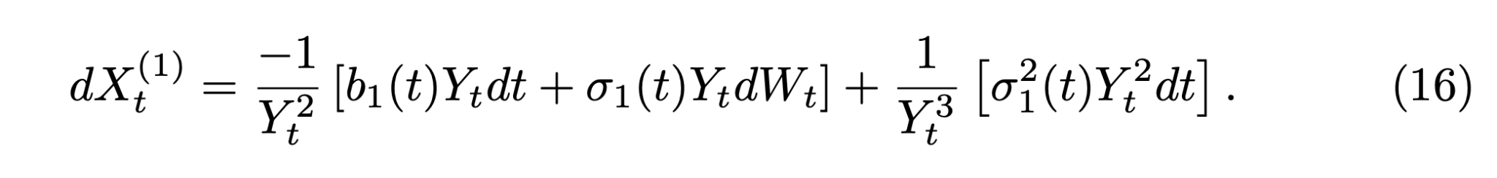
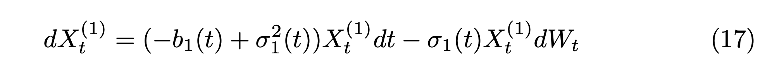
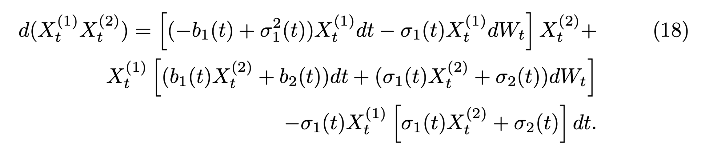
The Inhomogeneous Linear SDE
Collecting terms…
We can now substitute this back into our initial expression to obtain

Slide 15
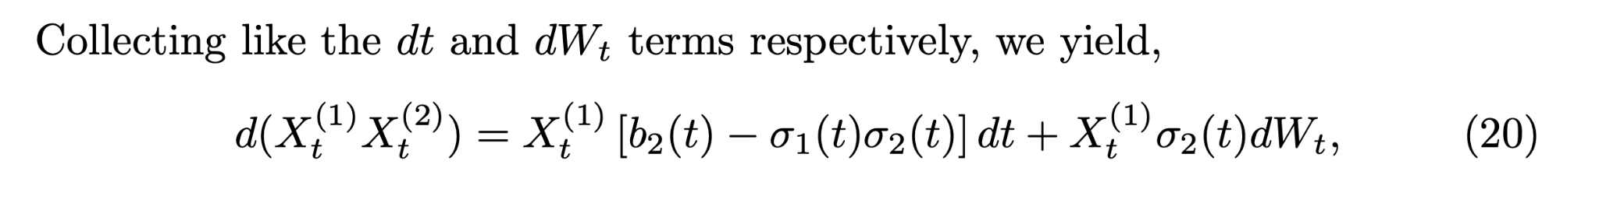
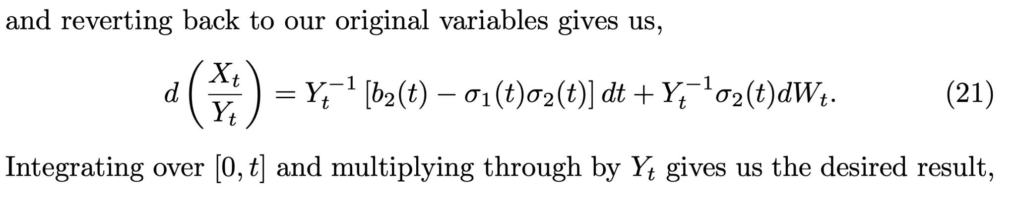
The Inhomogeneous Linear SDE

Slide 16
Where can we go from here?
For what we want to do, there are numerous problems still to consider:
Most SDE’s are not linear!
Data is not continuous in time (some approximation will always be needed)
Integrals may not be possible to solve analytically - may require numerical estimation anyway.
So instead we can take a different approach…

Slide 17
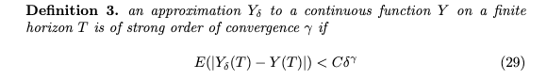
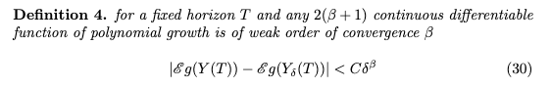
Numerical estimation
In the cases we cannot find an expression for the solution to an sde we can use approximation schemes to approximate the trajectories of an SDE, each of these have different orders of strong and weak convergence which are important in deciding which scheme to use. First we define the convergences formally

Slide 18
The relationship between convergence value and accuracy is that accuracy is proportional to the convergence value multiplied by time interval.
Strong convergence is how accurate the approximation is over the whole time period
Weak convergence is how accurate the final value is at time T on the horizon
Schemes that have a high strong convergence and weak convergence have less efficiency when it comes to coding, ie they involve more calculations.

Slide 19
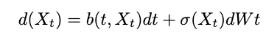
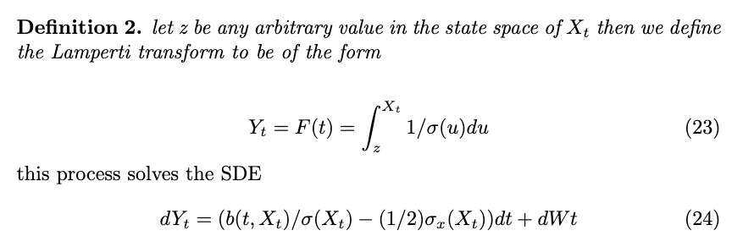
Lamperti transform
Before we delve into the numerical estimation techniques we have to define the lamperti transform as some schemes require it to be done before proceeding. It also reduces computation time in some cases. Consider the SDE
then the lamperti transform unitises the volatility term

Slide 20
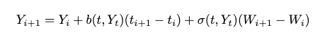
Euler scheme
this scheme estimates the SDE by providing a step function dependent wholly on known constants, We then use linear interpolation ( joining up the lines) to provide a function.
We consider the arbitrary SDE and take a time period split up into arbitrary intervals then we have that the euler scheme is a step function given by
Where Y_0 is X_0
Strong order of convergence: ½
Weak order of convergence: 1

Slide 21
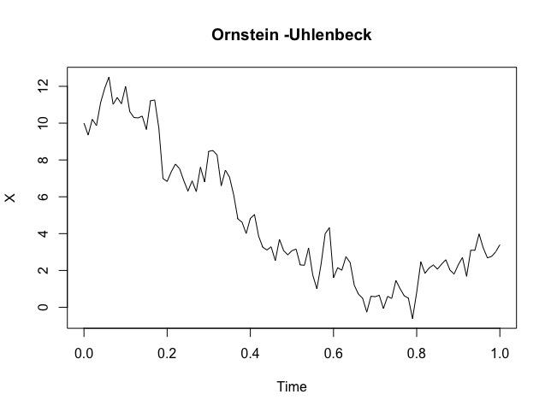
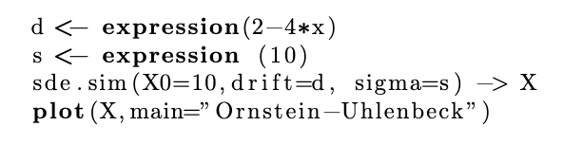
Here is a euler scheme plot of the Ornstein-Uhlenbeck SDE using the SDE.sim function
Note we wouldn’t necessarily want to approximate this sde given that it has a solution, alongside GBM and CIR, we could use the SDE.sim’s model parameter to simulate without discretisation

Slide 22
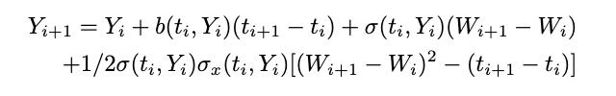
Milstein scheme
This scheme is essentially the same as the euler scheme but its adds more terms to improve strong order of convergence, with a small drop in efficiency as it requires more calculation. The scheme also creates a step function with
Note: this improves the strong order of convergence to 1

Slide 23
Looking at the equation above this is exactly the Euler scheme with an extra term, if the volatility term was constant this would give the exact same approximation as the Euler scheme since the derivative with respect to x would disappear, this is our next result

Slide 24
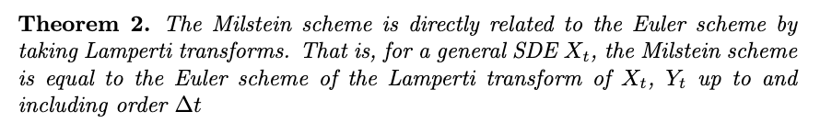
Comparison between euler and Milstein via Lamperti transform
More efficient code due to less calculations
Implement trades based on data faster
Better for high frequency trading

Slide 25
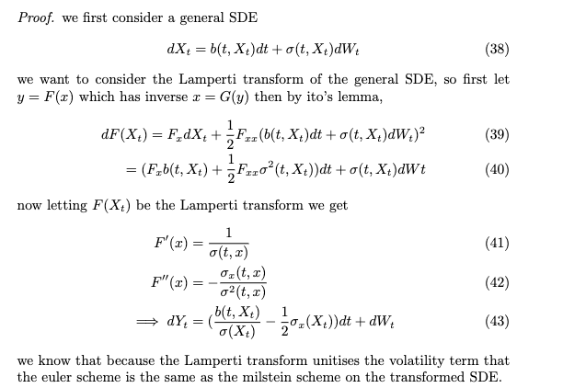

Slide 26
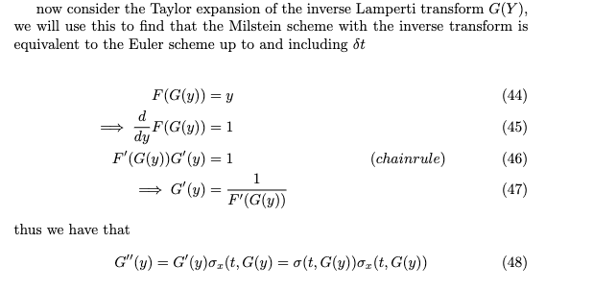

Slide 27
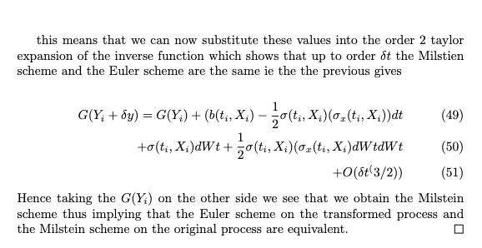

Slide 28
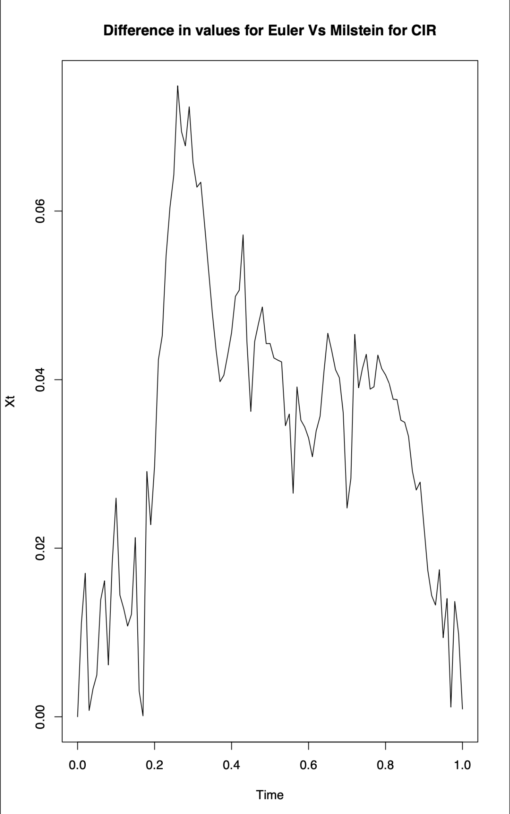
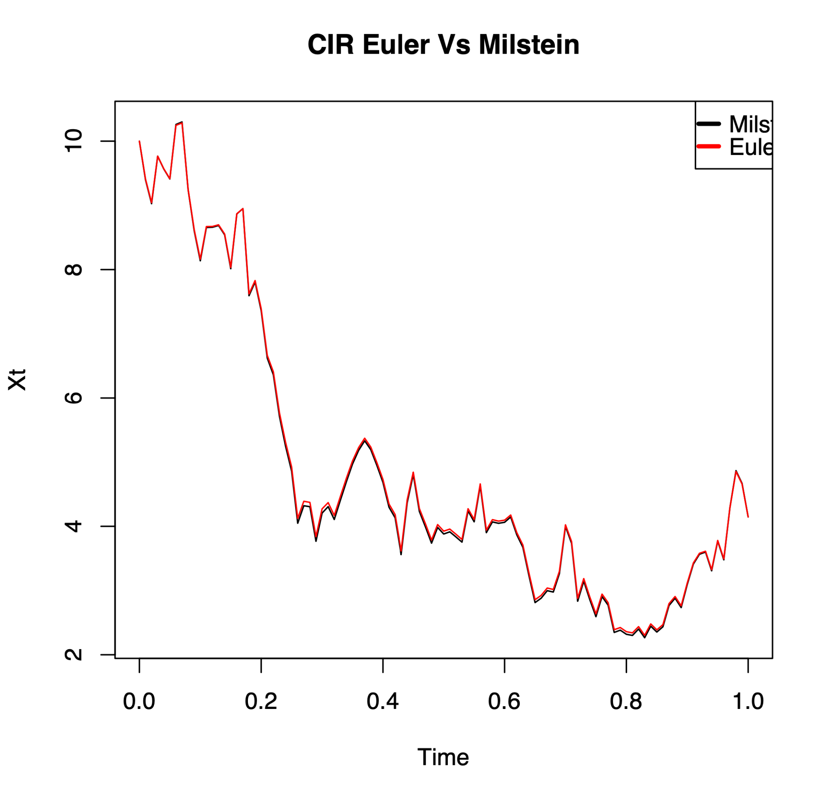
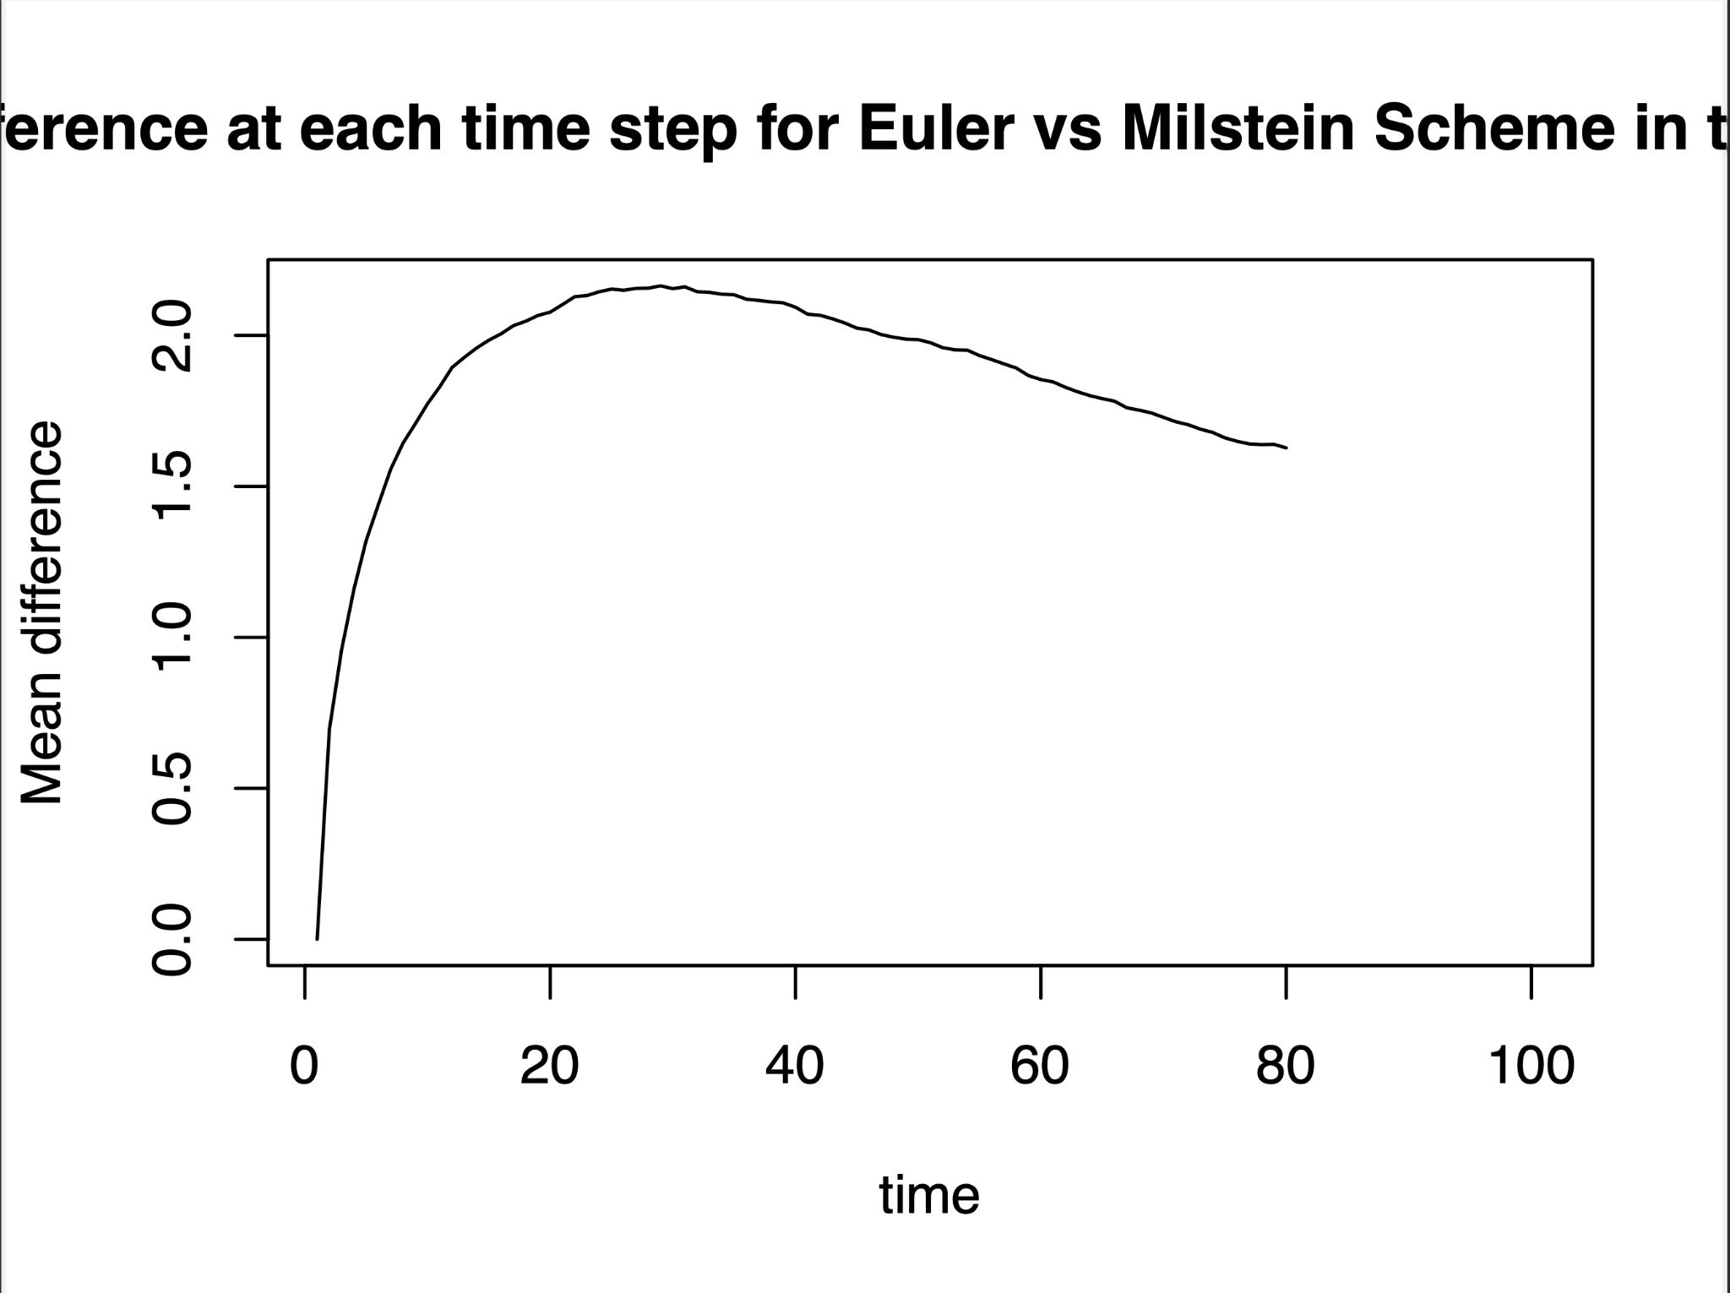
Qualitative comparison of Euler and Milstein in the CIR model
Mean difference in values

Slide 29
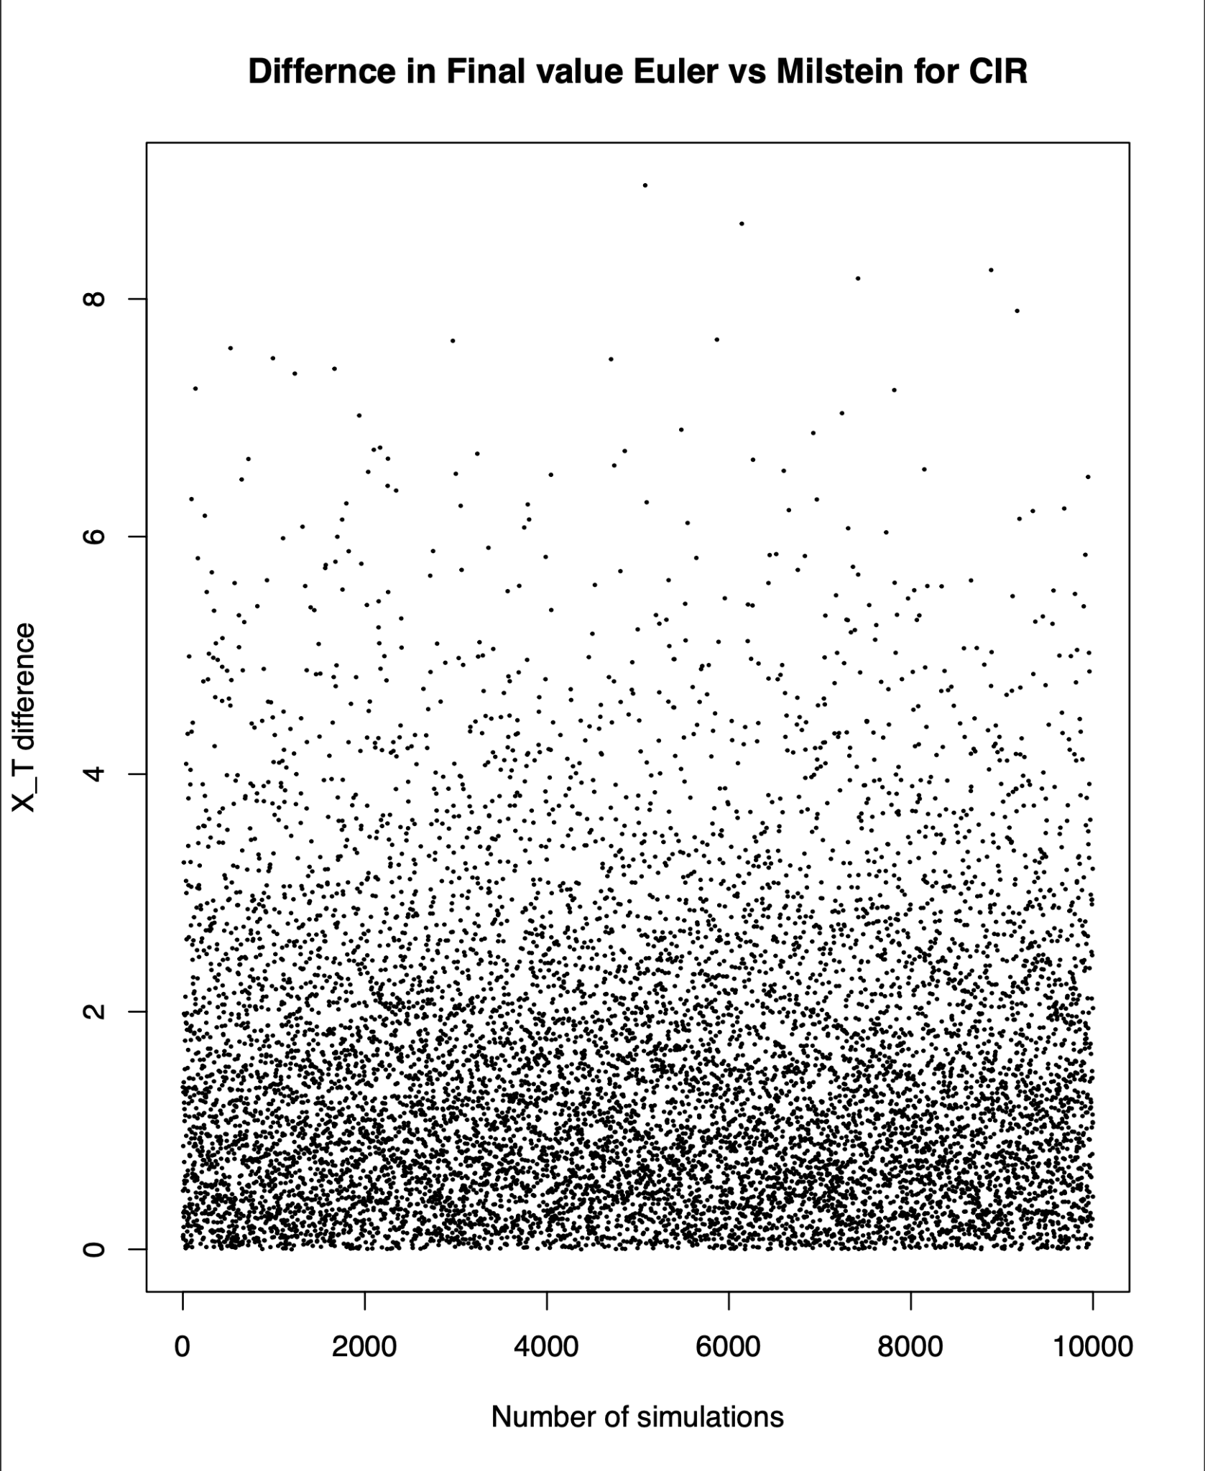
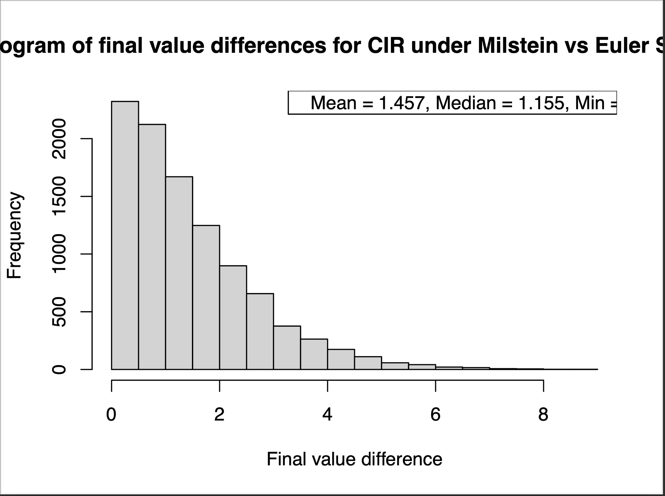
Qualitative comparison of Euler and Milstein in the CIR model
Histogram of final values

Slide 30
Other discretisation methods
Depending on what our goals are we may want to increase strong or weak orders of convergence even more, especially if code efficiency is not a concern.
The milstien 2 scheme which increases the weak convergence to 2 and keeps the strong convergence of the Milstien scheme.
Or we could use kps which increases strong convergence to 1.5 and keeps the weak convergence of the euler scheme

Slide 31
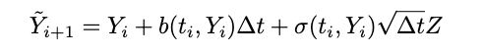
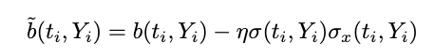
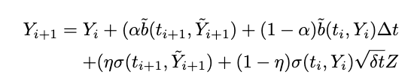
Predictor corrector method
The euler and milstein schemes have a small issue, they both assume the drift and volatility terms are constant on each interval, however this is not necessarily the case. the method works by predicting what we think the next step will look like (the predictor), and then upon t_i+1, takes a weighted average of the prediction and the new data point to find the corrected approximation to the SDE. the predictor is as follows:
We note that alpha and eta are probabilities and
And the correction term which generates the step function is :
Also if alpha and eta are 0 it falls back to the euler scheme

Slide 32
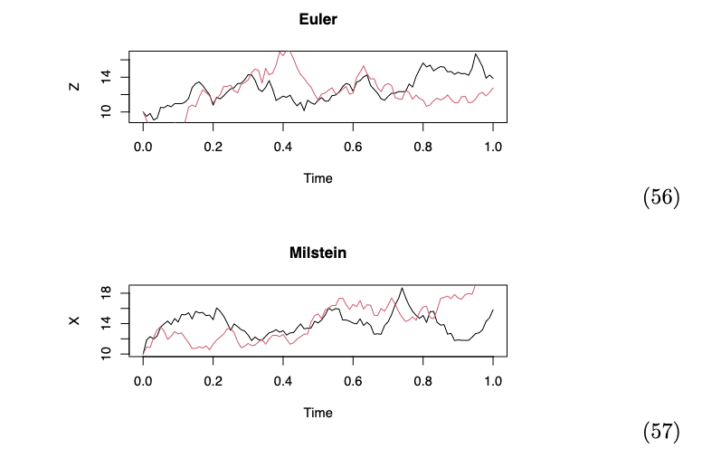

Slide 33
Local Linearisation methods
We explore the Ozaki method and Shoji Ozaki method which estimate the drift of the sde by a linear function.
This is meant to be better than using a constant approximation

Slide 34
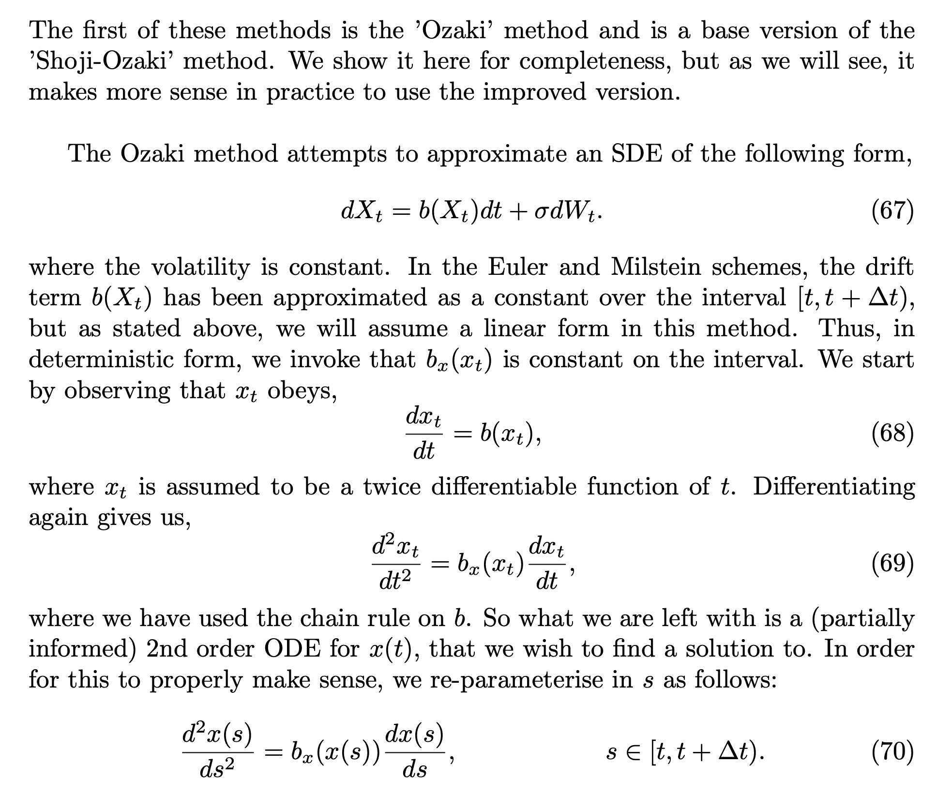
Ozaki method

Slide 35
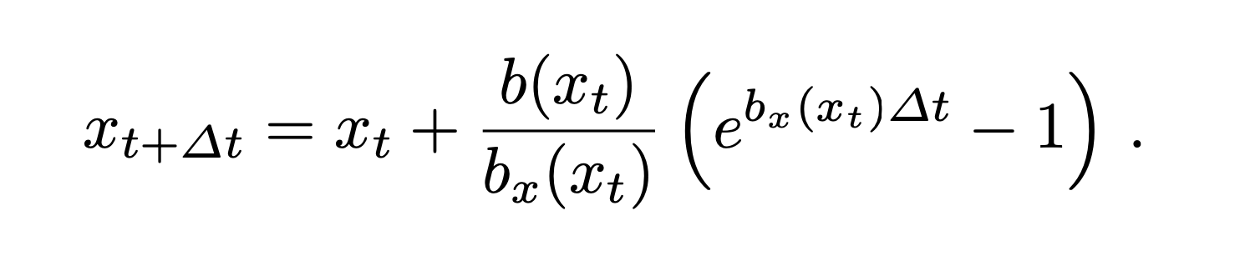
Ozaki method
…

Slide 36
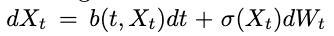
Shoji Ozaki method
This method is an extension of the Ozaki method that works for a more general set of SDE’s, we can now allow the drift term to depend on t which was not the case in the ozaki method.
This works for all SDEs of the form
We are allowed to extend this to the sdes with volatility depending on the state variable since we can just use the lamperti transform and then transform the answer back.

Slide 37
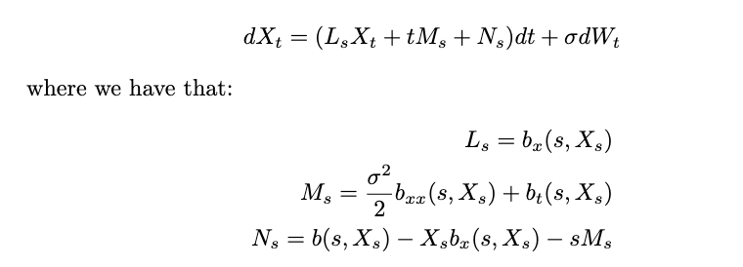
Once we have some sde X_t in the correct form then we can approximate it by

Slide 38
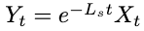
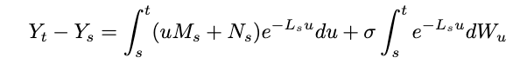
Using the same methods from maths finance iii we can find a solution X_t by using ito's lemma on
We get the expression
Once we have this, we can read off the solution for X_t and also find the conditional distribution of X_t|X_s

Slide 39
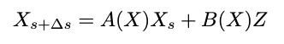
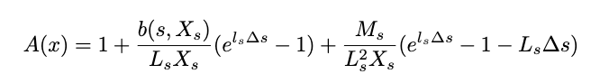
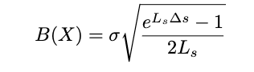

(Deterministic integrals)
(Standardising the normal distribution after taking exp and var )
(conditioning on s and taking expectation and variance)

Slide 40

SDE.sim function
At this point it is a good idea to display what we can do with the algorithms and schemes we have learnt thus far. The sde.sim function compiles everything we know into one simple function making it easy to use in R.

Slide 41

Where do we go from here?

Slide 42

Monte carlo for pricing options

Slide 43




Slide 44



Slide 45
Thanks for listening !

